Slide 1
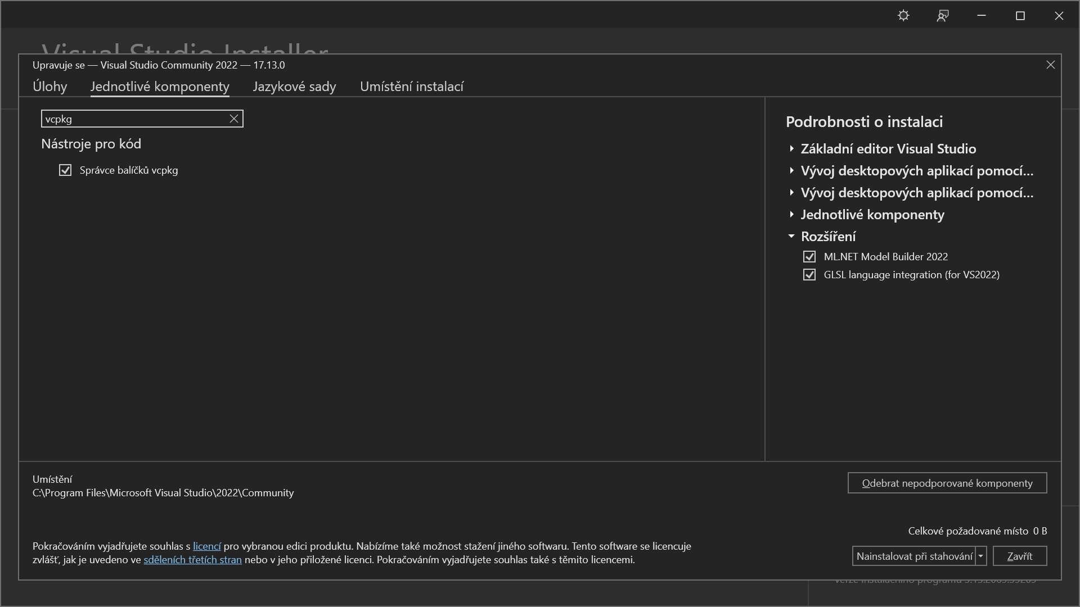
Install VCPKG using Visual Studio 2022 installer
free and open-source C/C++ package manager
https://github.com/microsoft/vcpkg

Slide 2
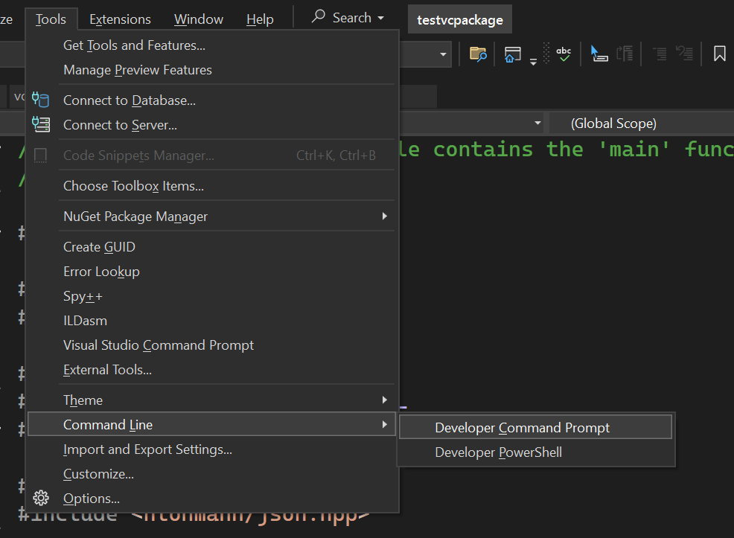
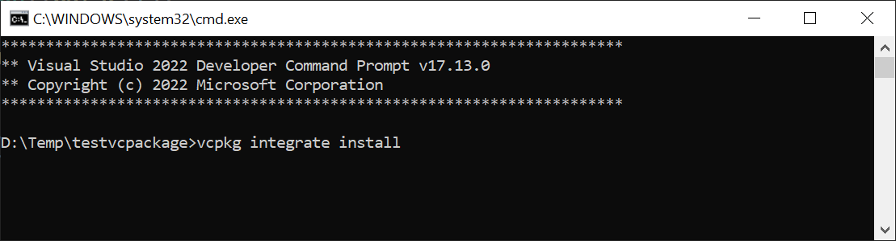
Integrate VCPKG with Visual Sudio
(and do not close the command line)

Slide 3
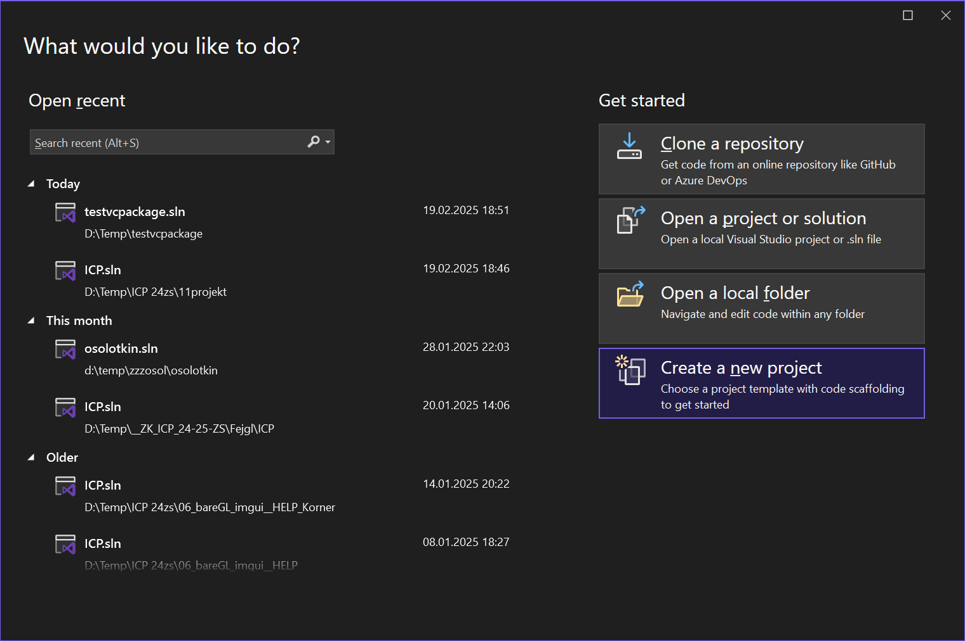
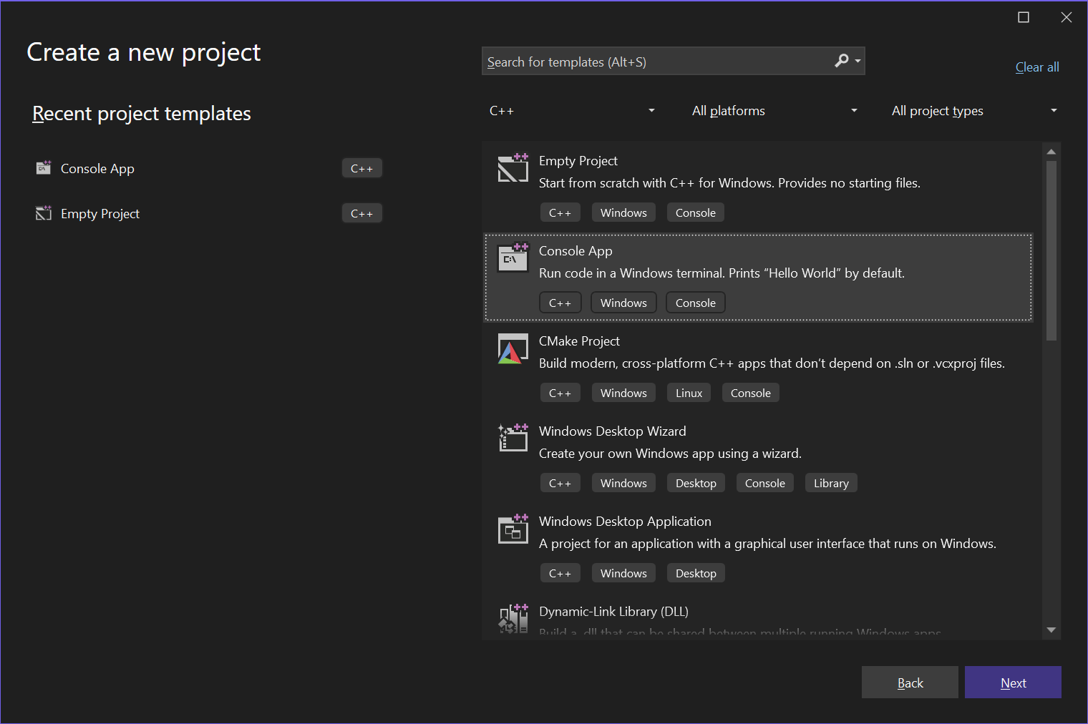
Set Project Dependencies
First, restart Visual Studio
Create new Console project

Slide 4
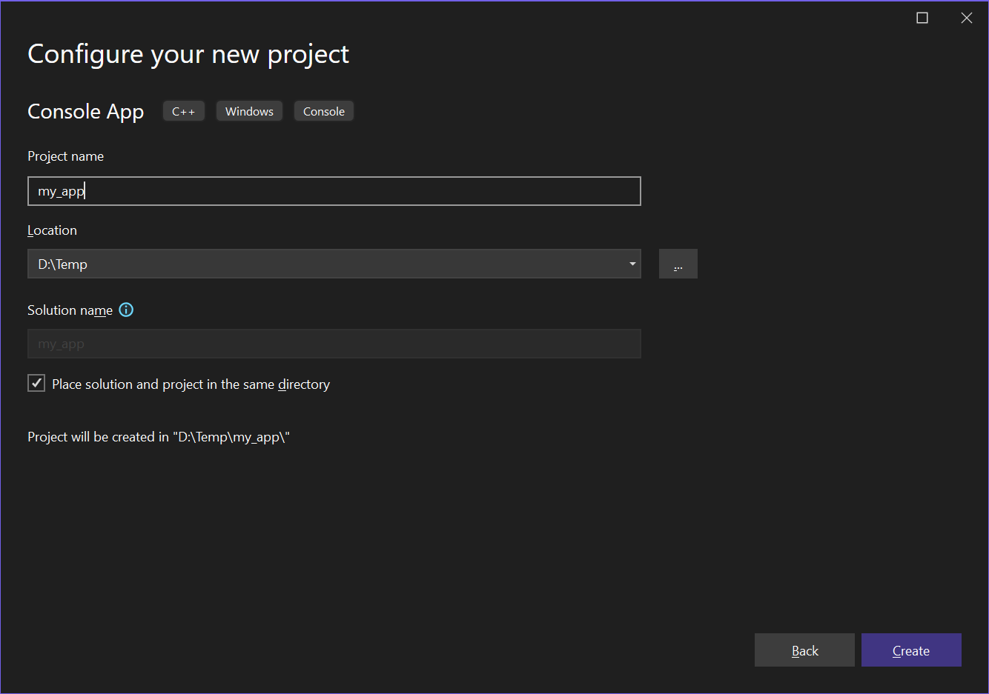
Initial Settings

Slide 5
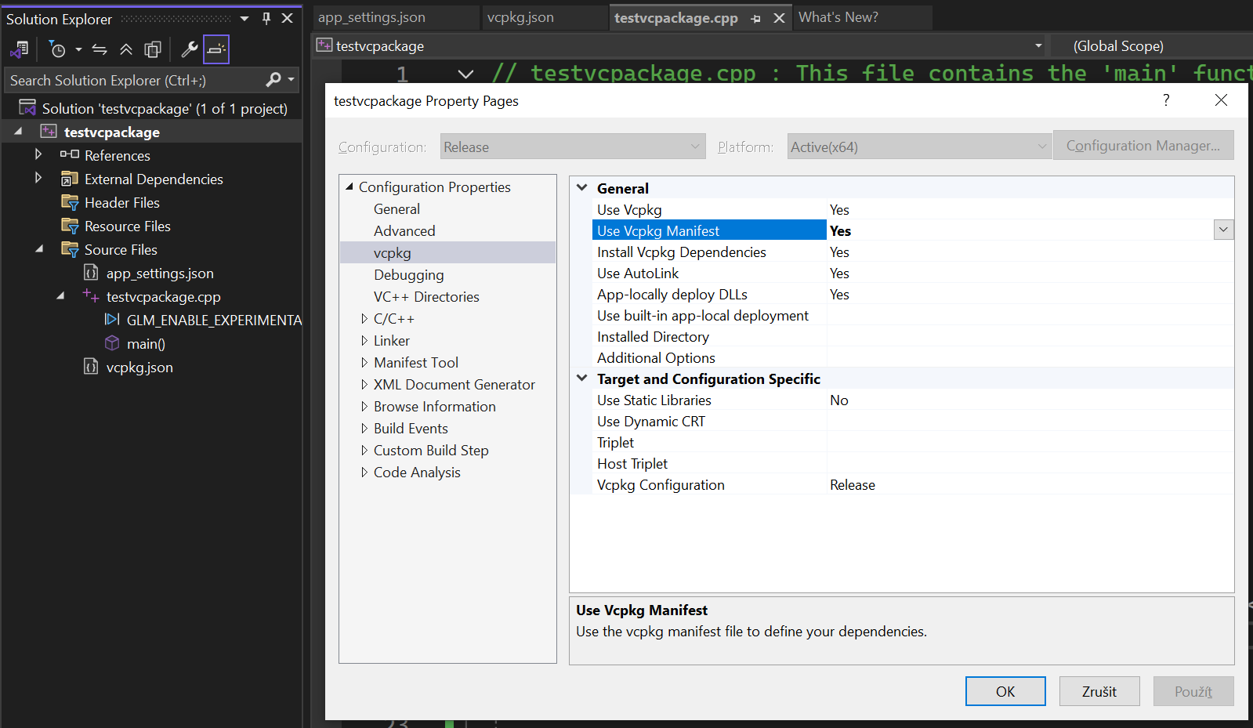
Set to Use Per-Project Dependencies

Slide 6
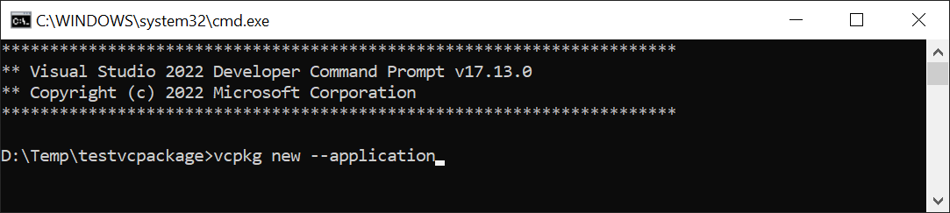
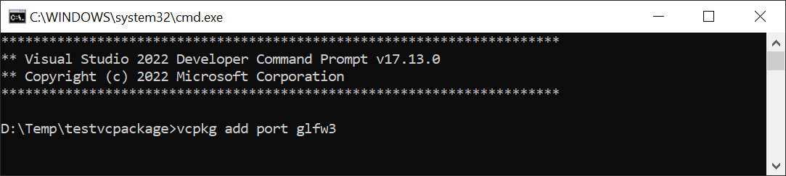
Create vcpkg.json Manifest and Add Dependencies
add dependencies
  glfw3, glew, glm, nlohmann-json
these will be carried per-project
optional: search other libraries, if you need them
  vcpkg search …

Slide 7
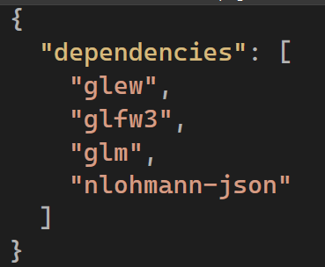
Verify vcpkg.json Content
Shift-Alt-A (add existing item)
  vcpkg.json

Slide 8
Install and Configure OpenCV
OS part
System-wide installation
  OpenCV is too large to carry per-project (800+ MB)
Linux – install package opencv-devel
Windows
  Download latest release from https://opencv.org/releases/
    e.g. opencv-4.8.0-windows.exe
  Extract OpenCV to C:\
  Add/change user specific system variable:
    Ovladaci panely → Uzivatelske ucty → Student → Zmenit promenne prostredi
    Control panel → User accounts → Student → Change system variables
  Add new variable
    Name: OPENCV_DIR
    Value: C:\opencv\build
  Modify variable PATH
    Add item
      %OPENCV_DIR%\x64\vc16\bin

Slide 9
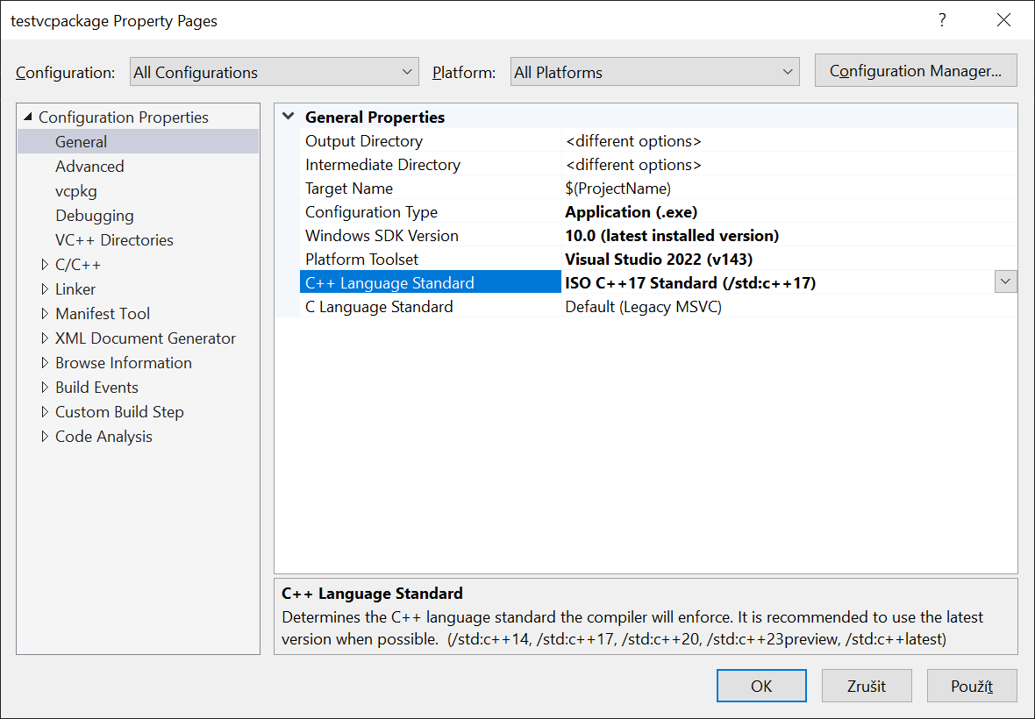
Configure Project C++ Version

Slide 10
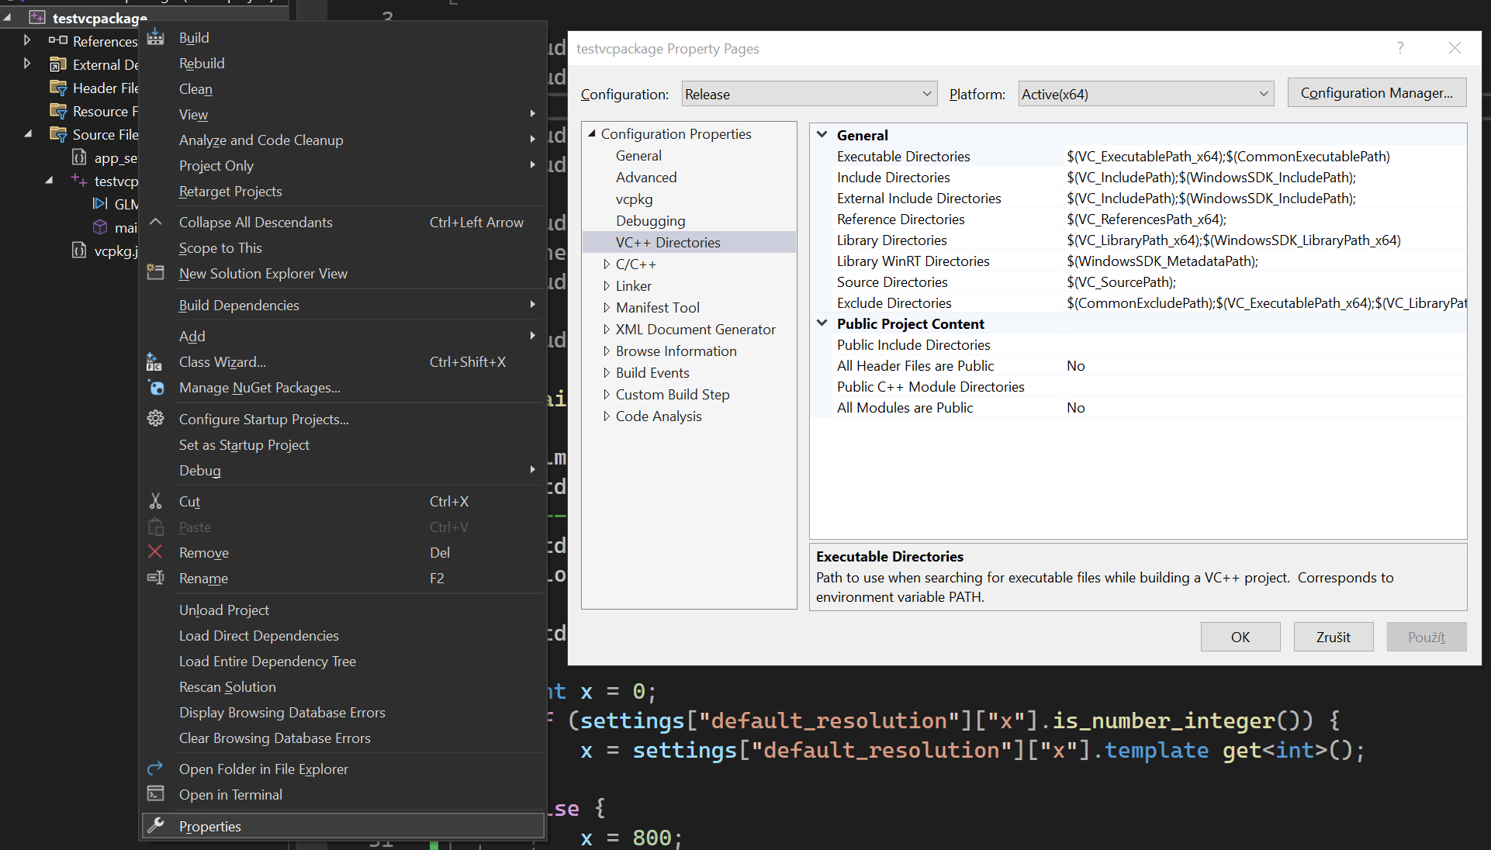
Configure Project to Use OpenCV

Slide 11
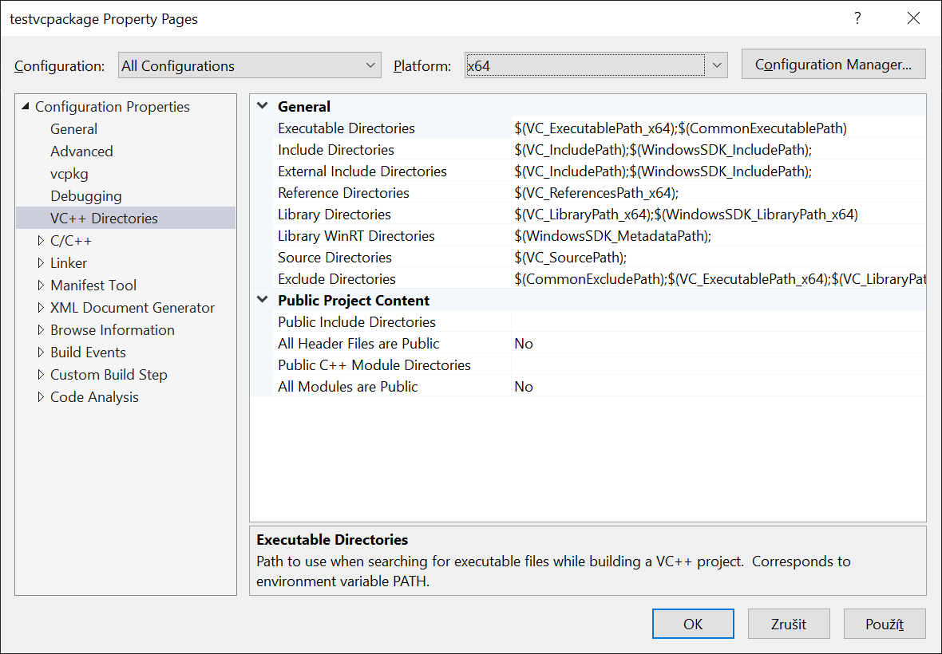
Modify Directories Settings
⚠ ADD entries, do not overwrite them
  executable
    $(OPENCV_DIR)\x64\vc16\bin;
  include
    $(OPENCV_DIR)\include;
  libraries
    $(OPENCV_DIR)\x64\vc16\bin;
    $(OPENCV_DIR)\x64\vc16\lib;

Slide 12
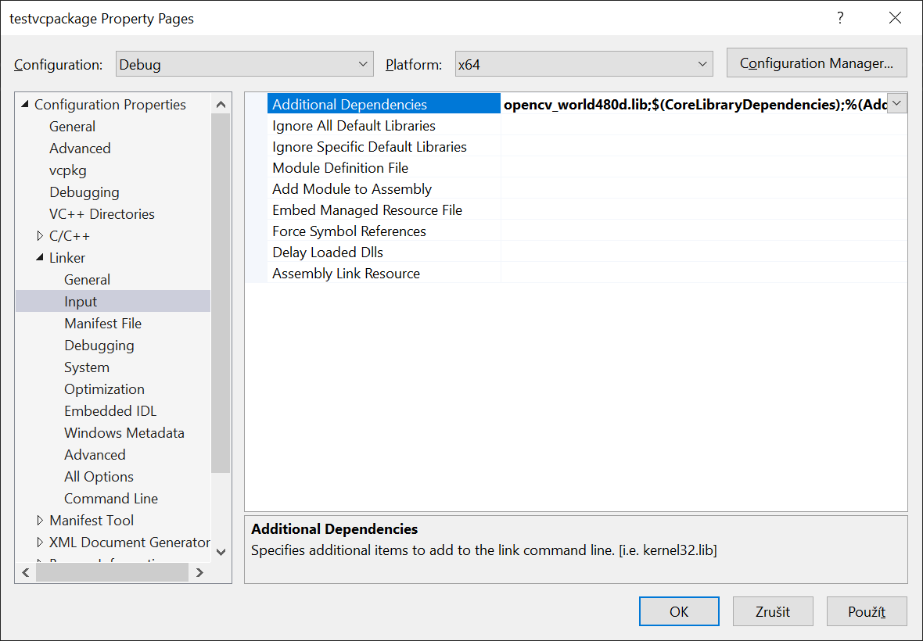
Modify Linker Settings
DEBUG config
ADD additional dependencies
  opencv_world480d.lib;
RELEASE config
ADD additional dependencies
  opencv_world480.lib;

